Slide 1



Modeling SABSA® in ArchiMate®
01
Practicing of Archi (ArchiMate Modeling Tool)

Slide 2
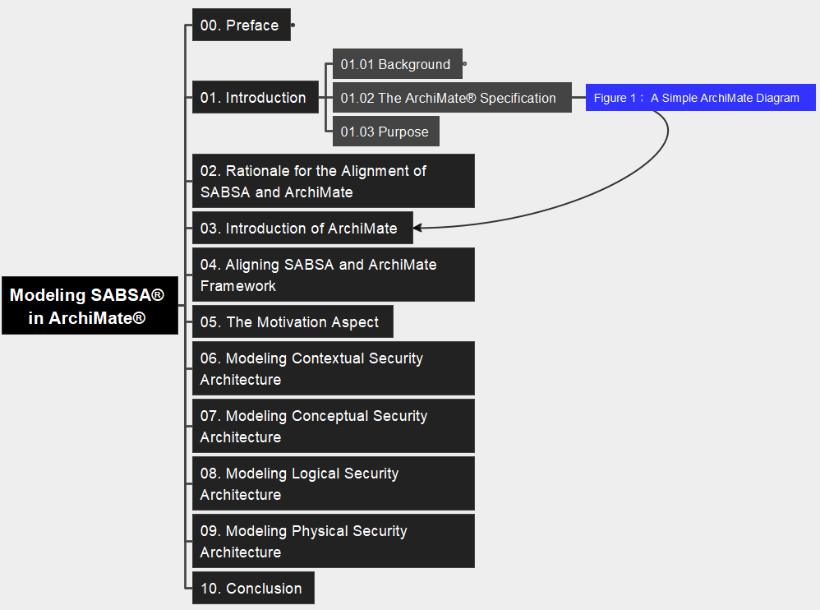
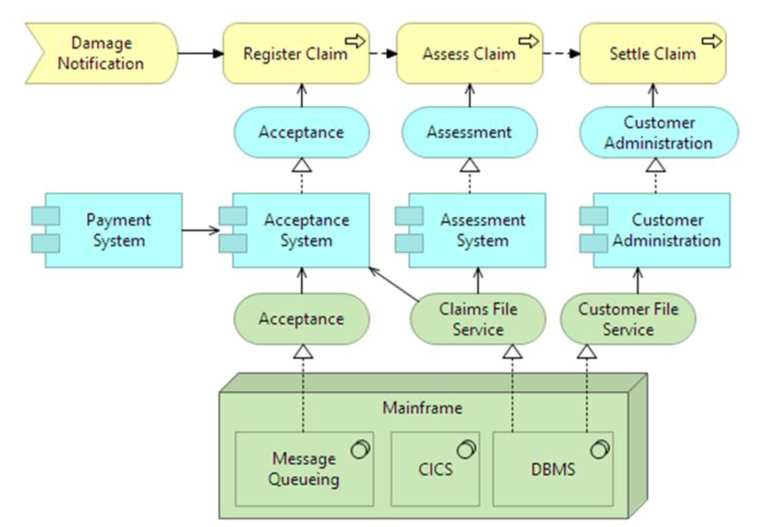
01 Introduction Figure 1: A Simple ArchiMate Diagram
02

Slide 3
01 Introduction F
03

Slide 4



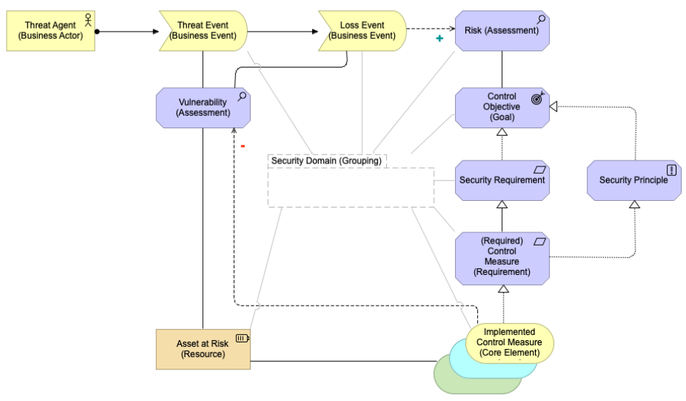
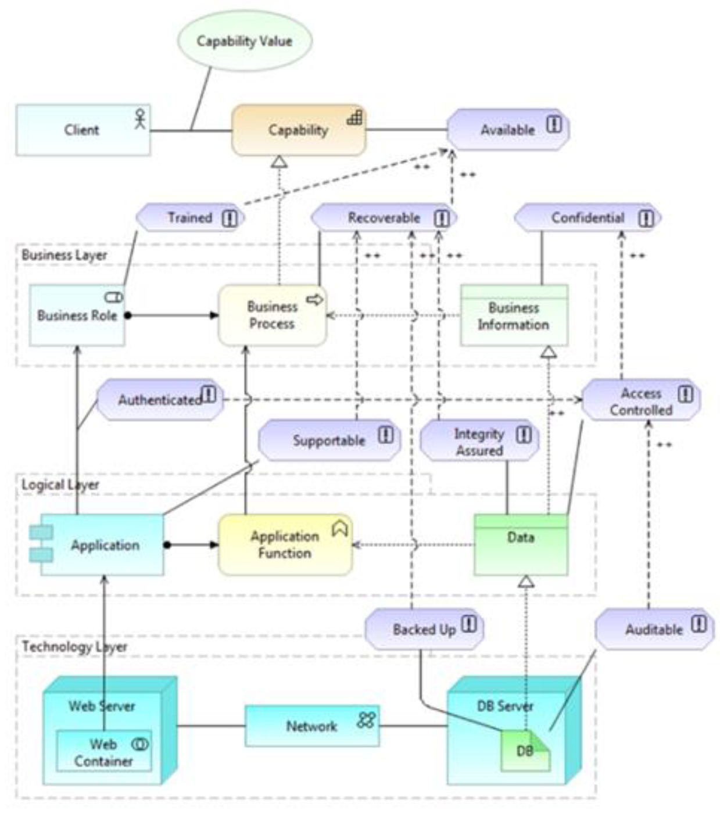
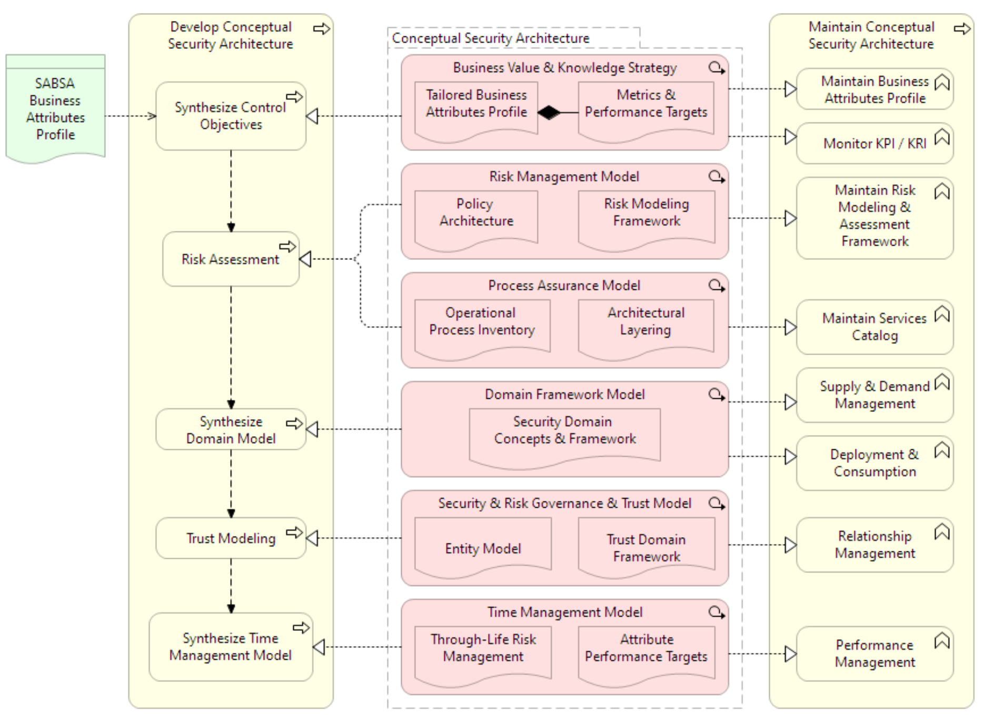
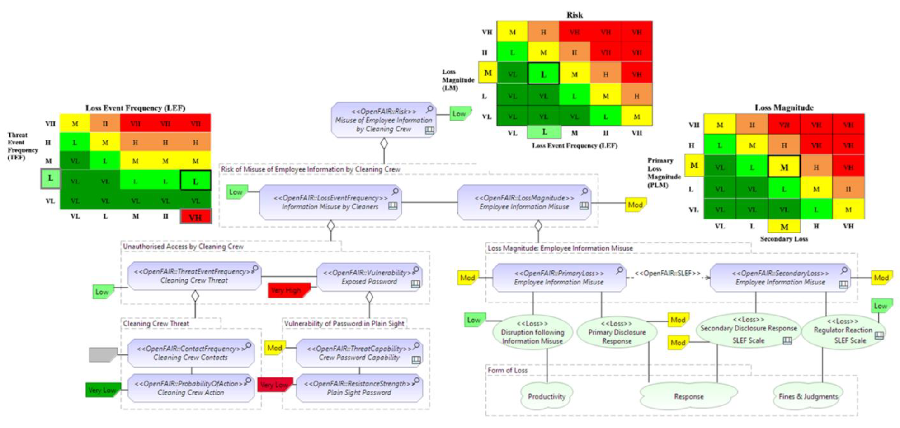

Slide 5




ArchiMate
UML
BPMN

